Slide 1
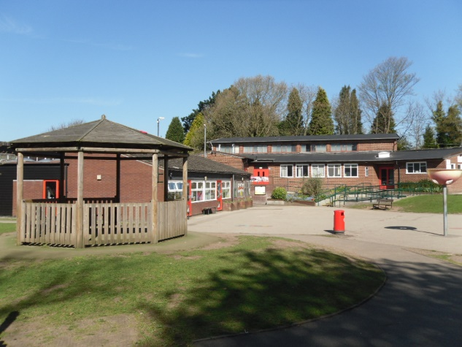

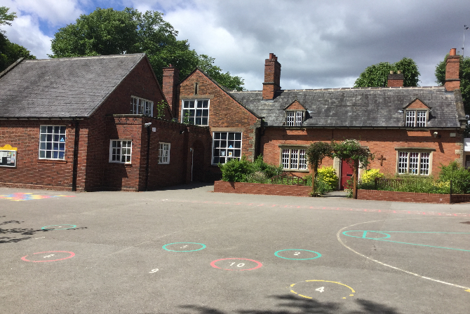
Welcome to
St. Peter’s CE Primary School
Through the teachings of God
we
Love Others Value Everyone

Slide 2

About Our School
We are a popular Church of England voluntary aided primary school.
We celebrate our distinctive Christian ethos and rich and diverse school community - SIAMs inspection May 2019 – Good.
We aim to work in close partnership with the church, the governors, our parents and community.

Slide 3
About Our School
We strive day to day to live by our school values:
  Respect – for one another
  Love – of God and one another
  Honesty – in the eyes of God and with each other
  Forgiveness – towards others in order to enable us to move forward.
  ‘Through the teachings of God we Love Others Value Everyone’

Slide 4

About Our School
Our provision continues to be judged as ‘Good’ with many strengths by OFSTED - October 2023.
Our end of key stage results are above national.
We are constantly striving to improve our provision and build on our previous best.
Visit our website to find out more at: www.st-petersce.co.uk

Slide 5
Ofsted October 2023
Pupils and parents value being a part of the school community.
Relationships are caring, supportive and reflect the school’s Christian values.
High expectations of behaviour and learning.
A well-led and inclusive school.
In English and Maths standards are strong.
School continues to offer a good quality education.

Slide 6
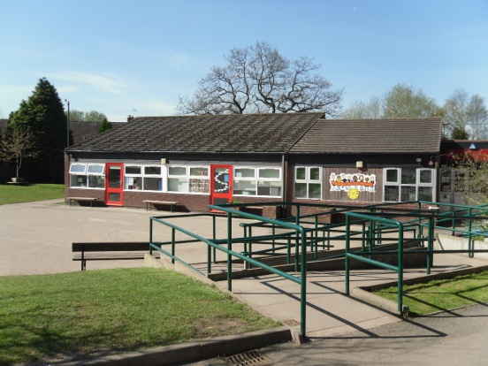
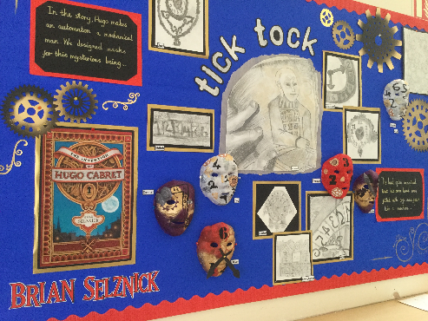
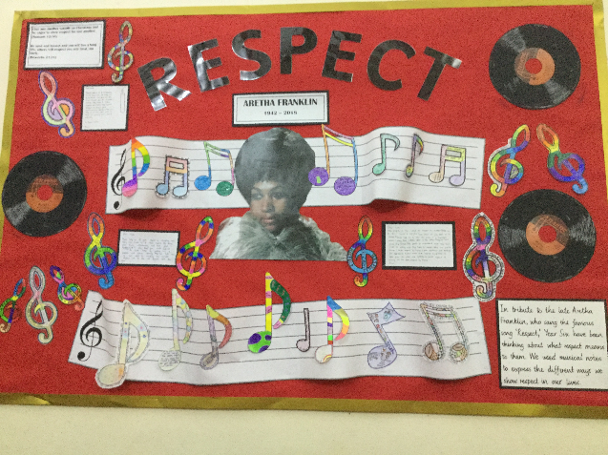
Why Choose St. Peter’s?
Distinctiveness as a church school.
Caring and inclusive school
School environment.
Excellent academic achievement and progress for all.
Experienced, capable and committed staff.
Notes:
Caring school – many comments from outside professionals and public about how caring we all are.

Slide 7
Why Choose St. Peter’s?
Emphasis on effective learning across a wide curriculum.
Commitment to educational visits and enrichment activities.
Excellent behaviour and positive relationships.
Notes:
Caring school – many comments from outside professionals and public about how caring we all are.

Slide 8
1) EHC or statement of special educational need that names this school. Looked after child or previously looked after.
2) Sibling qualification
3) Faith Claim
4) Distance The local authority measures from the address point of your home to the school using a computerised mapping system called Cartology. Do not try and work this out yourselves by road! They can tell you your distance from any school.
Criteria
for allocating 60 places
- For this purpose “home” is the child’s main place of residence.
- The child needs to be resident there when their name is added to the list.
- We routinely request proof of address and birth certificates for all pupils before admitting them.
Notes:
Faith claim – refer to admissions policy - point 3.

Slide 9
Further Information
Please make sure your forms are submitted by 15th January 2026.
If/when you are offered a place (16th April 2026) be prompt and frank in accepting/declining (by 30th April 2026) and in providing us with information about your child.
Apply sooner rather than later to the before and after school club.
We can advise you about our waiting lists for a Reception place from 7th May 2026.
If you accept a place, a parents meeting is arranged for after school in July for information sharing.

Slide 10
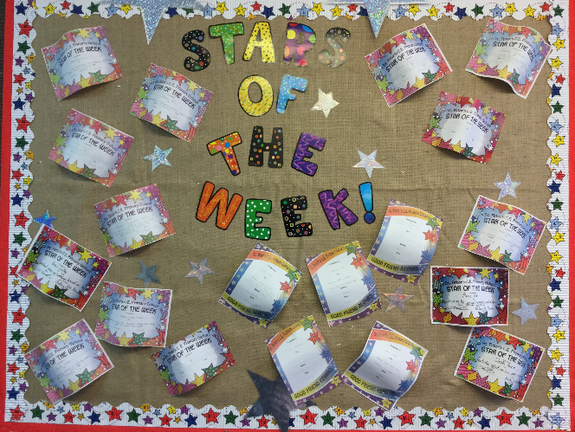
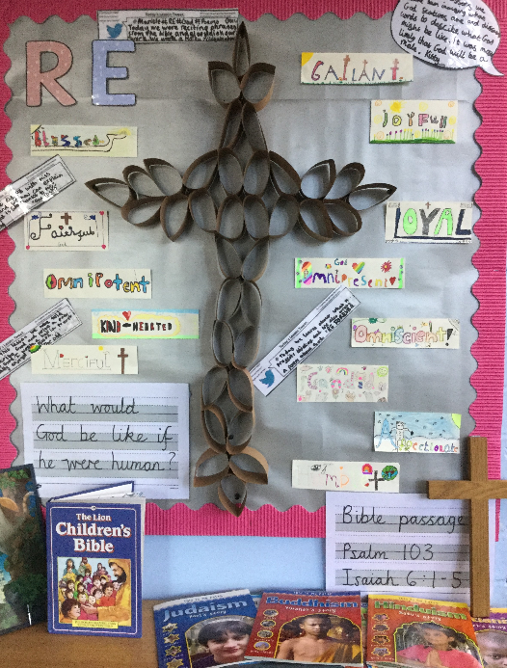
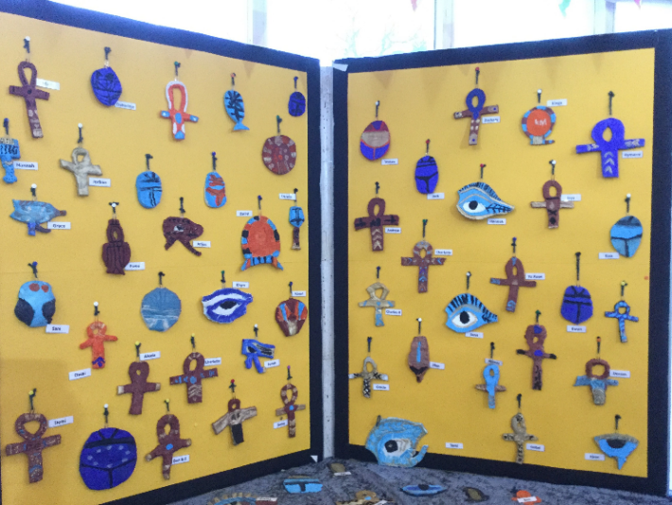
Visit Our School Website
www.st-petersce.co.uk
Weekly & monthly newsletters
A range of school policies
Class pages
Photo galleries of school events

Slide 11
Thank You for Attending
Please feel free to stay for a guided tour in the infants and juniors.

Slide 12
Numbers for St. Peter’s Primary
60 places per year.
Criteria 1 SEN
0-3 children each year, LAC- 0-2 children each year
Criteria 2 Siblings
2023 – 18/60, 2024 – 28/60,
2025 – 18/60
Criteria 3 Faith
21/60 in 2023, 7/60 in 2024 in
6/60 in 2025
Criteria 4 Distance- the remainder of the 60 places.
Notes:
First distance on the waiting list was 240m from school and the furthest distance was 5006m.

