Slide 1

Reserving books from home
‘How to Guide’

Slide 2
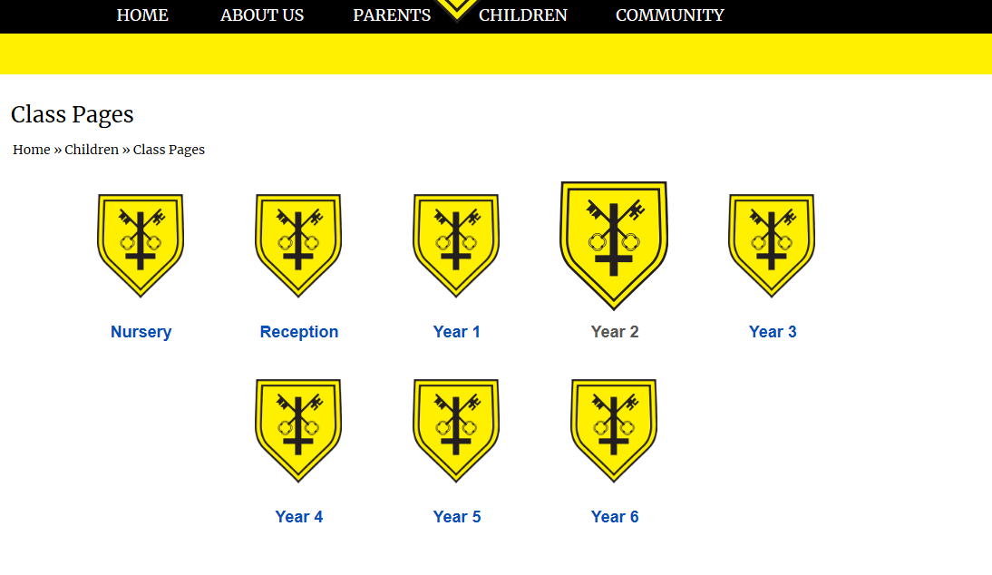
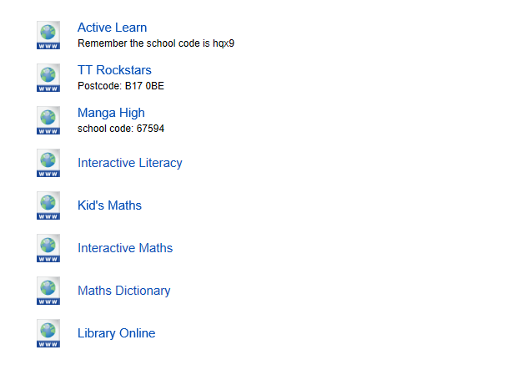

Log on to the school website and find your class page…
Scroll down until you find…

Slide 3
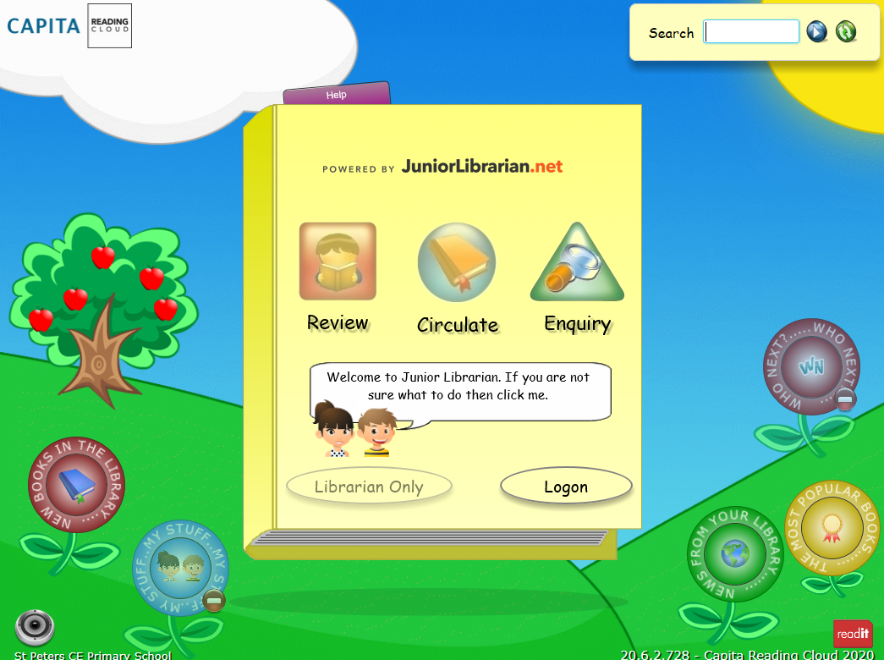
Double click and you will see this screen.

Slide 4
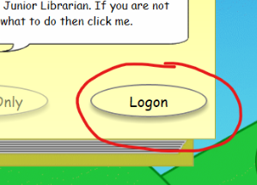
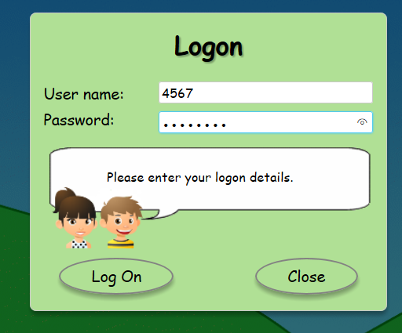
Click ‘Logon’ and type your 3 or 4 digit library number as your ‘User name’.
Your password is your date of birth; ddmmyyyy
For example, if you were born on the 1st January 1900,
You would be very old,
Your password would look like this: 01011900

Slide 5
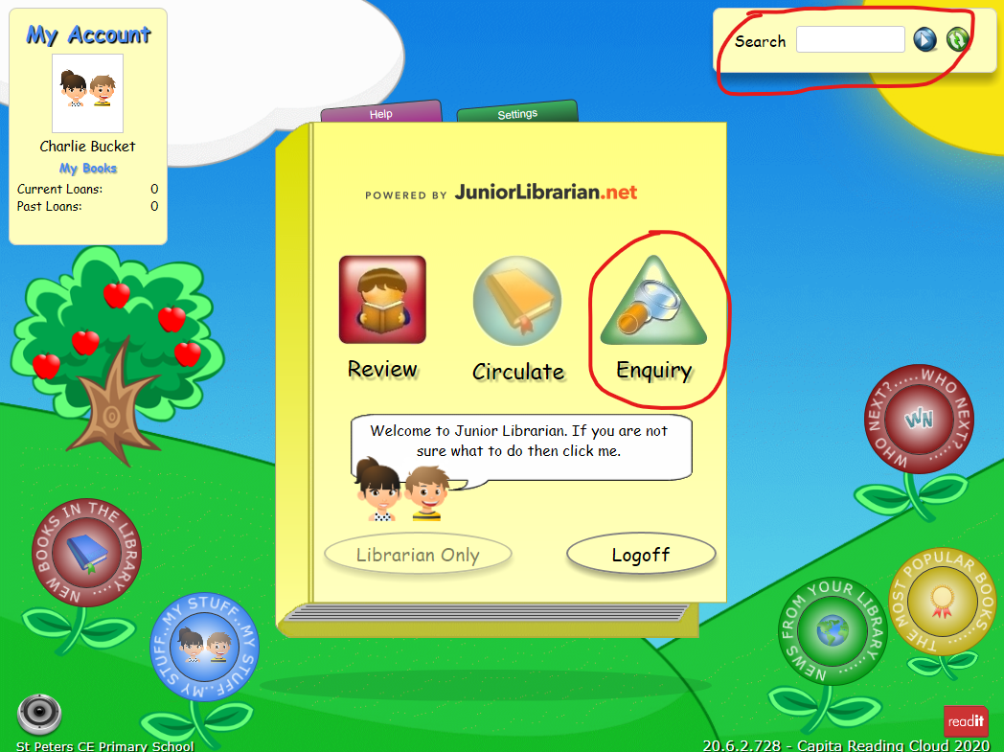
To look for a book, either use ‘Search’, if it is a title or an author you are looking for or ‘Enquiry’, if you are searching for a particular topic or subject.

Slide 6
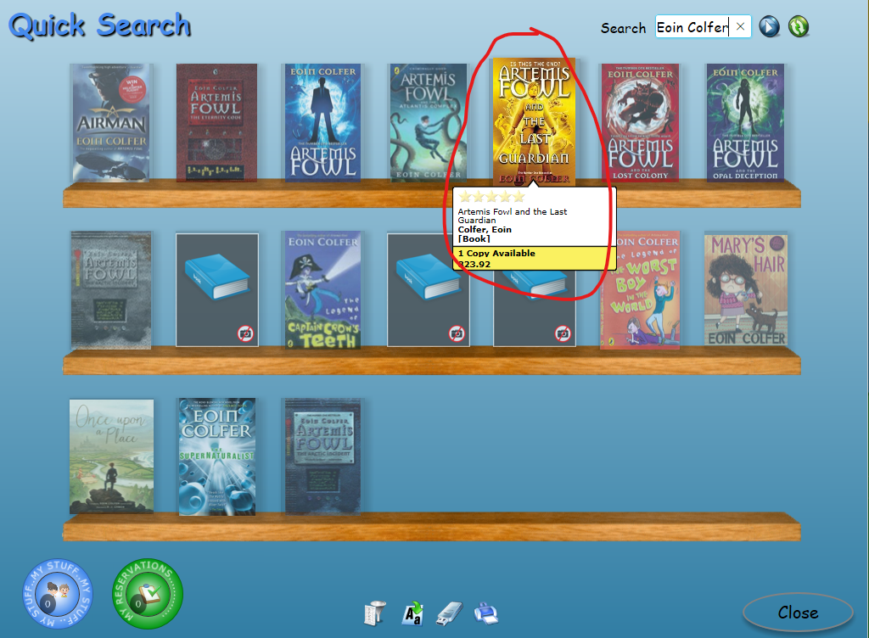
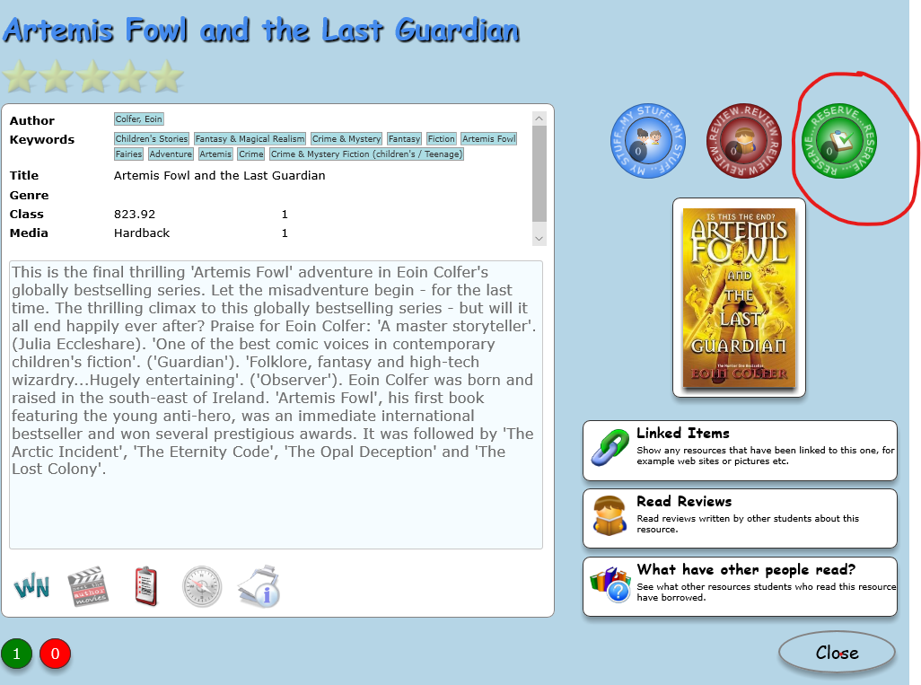
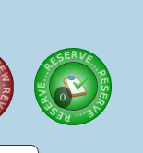
SEARCH
Type the name of the book or the author in the search bar. Click on the book you would like to read. If the book is not available, a 0 will show in the green circle beneath. If it is available, click the green ‘Reserve’ circle.

Slide 7
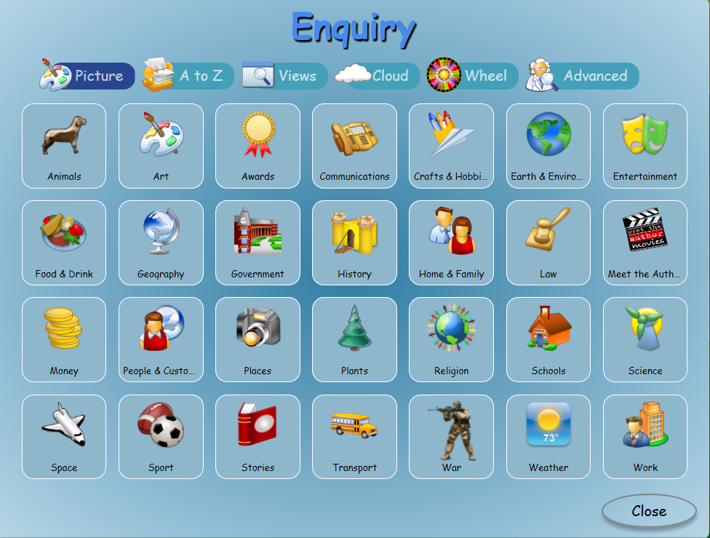
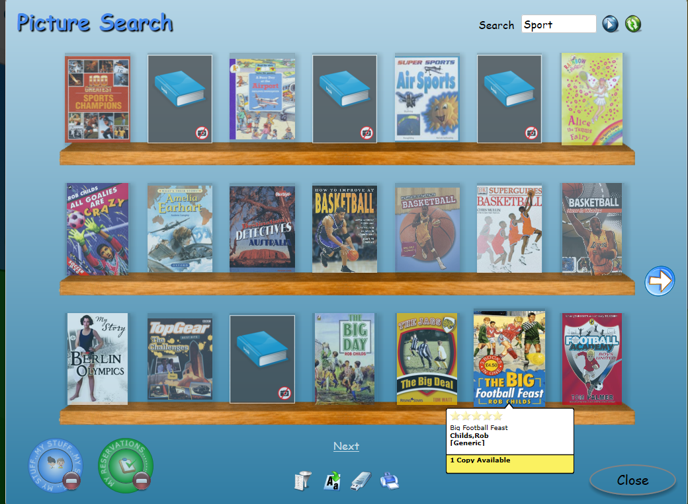
ENQUIRY
For example, clicking on ‘Sport’ will result in fact and fiction books.

Slide 8
JOB DONE!
Mrs Rigby will check every day for reservations and will deliver them to your classroom for you to read at school.
We are very sorry, but at the moment the books cannot go home.
Please be aware that if a title is popular, waiting times will be even longer than usual.
If you have any problems at all, please let Mrs Rigby know.

