Slide 1

Year 6 Parents’ Meeting
2025

Slide 2
Welcome to Year 6
Who we are…
6T
Teaching staff
Mr Thomas
Mrs Rigby
Mr. Jarrett (French, Music alternate Weds pm)
Mrs. Onions (Computing alternate Weds)
6S
Teaching staff
Mrs. Stimpson
Mrs Rigby
Mrs Onions (Thursdays)
Mr. Jarrett (French, Music alternate Weds pm )
Mrs. Onions (Computing alternate Weds)

Slide 3
What you need to know…
School starts at 8.55 am. This is not a flexible drop off time – please ensure that your child is on time.
Your child may bring a water bottle, a coat, a lunchbox, healthy tuck (where applicable) and a pencil case.
School ends at 3.25. In Year 6, children can start to walk home by themselves but they must have a signed note from their parent granting permission for this to happen.

Slide 4
Our School Values
Love
Respect
Honesty
Forgiveness
These values are central to our behaviour expectations at St. Peter’s. In Year 6, children are encouraged to display and ‘live’ these values as role models to our younger children.
Assemblies and Church worship focus on these key values (and others) throughout the year.
Our Relationships, Sex and Health curriculum allows us to explore mental health and wellbeing in depth.

Slide 5
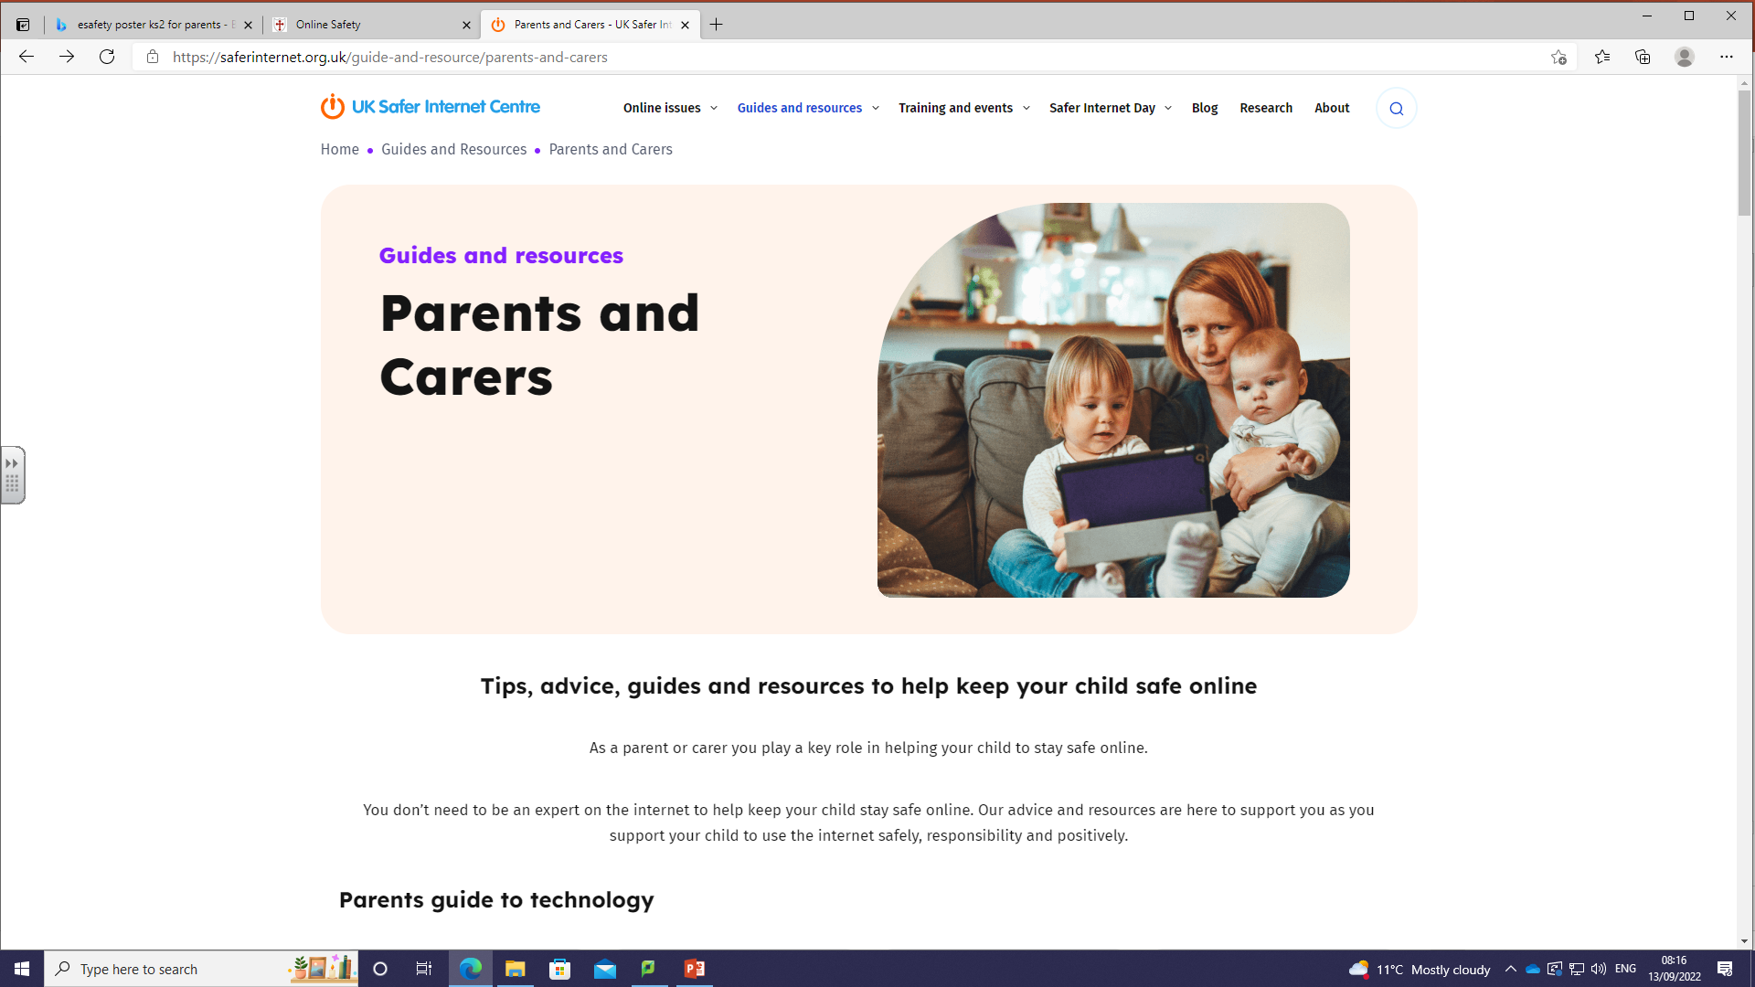
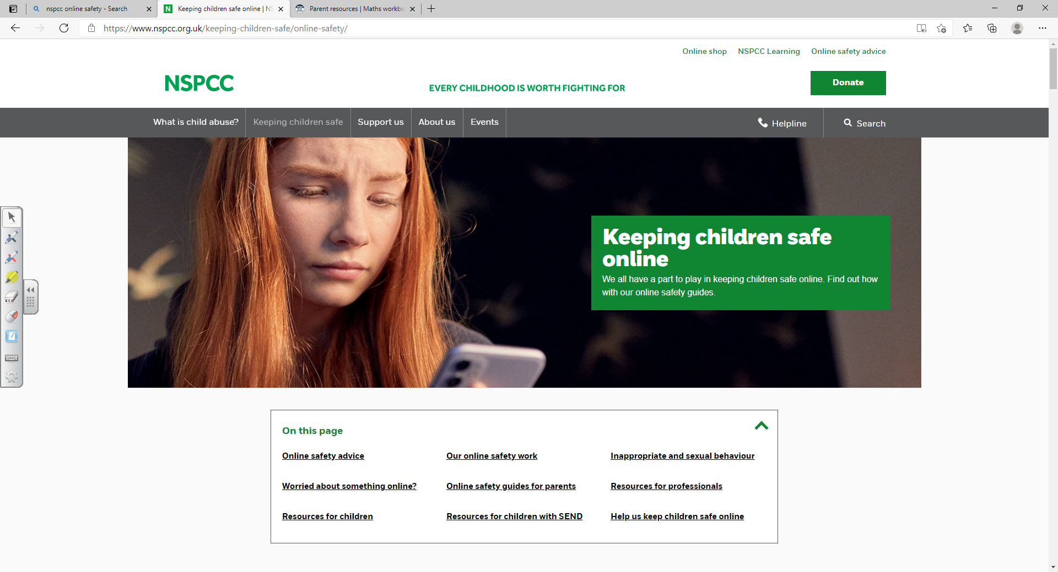
Online Safety
https://saferinternet.org.uk/guide-and-resource/parents-and-carers
Parents and Carers - UK Safer Internet Centre
Keeping children safe online | NSPCC

Slide 6

Children are not to use mobile phones on school grounds.
Mobile phones that are needed for children who walk home from school will be securing stored in the school office during the day.

Slide 7

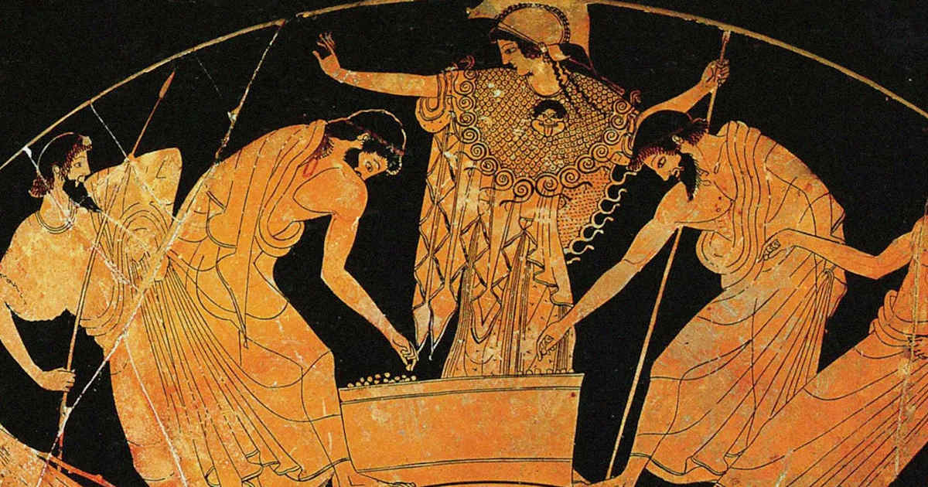
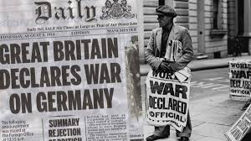
Year 6 Topics
Autumn Term
Britain at War
Geography – Times Zones/Global trade
Spring Term
Ancient Greece
Geography – Sustainable World
Summer Term
Geography – linked to the Lake District
Production Focus

Slide 8
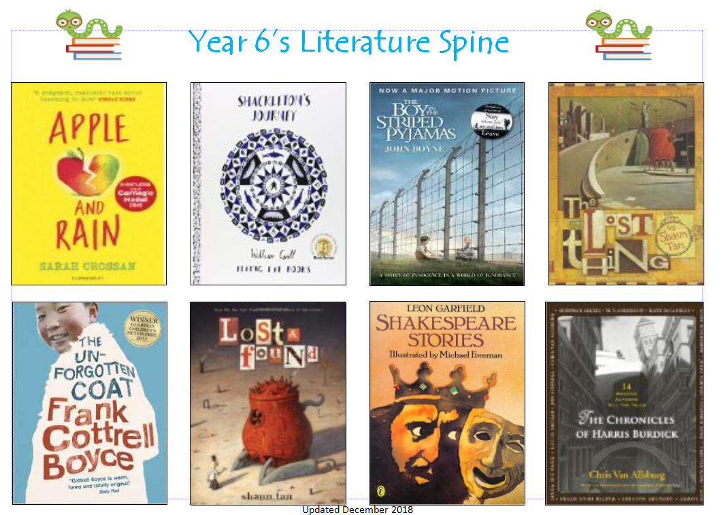
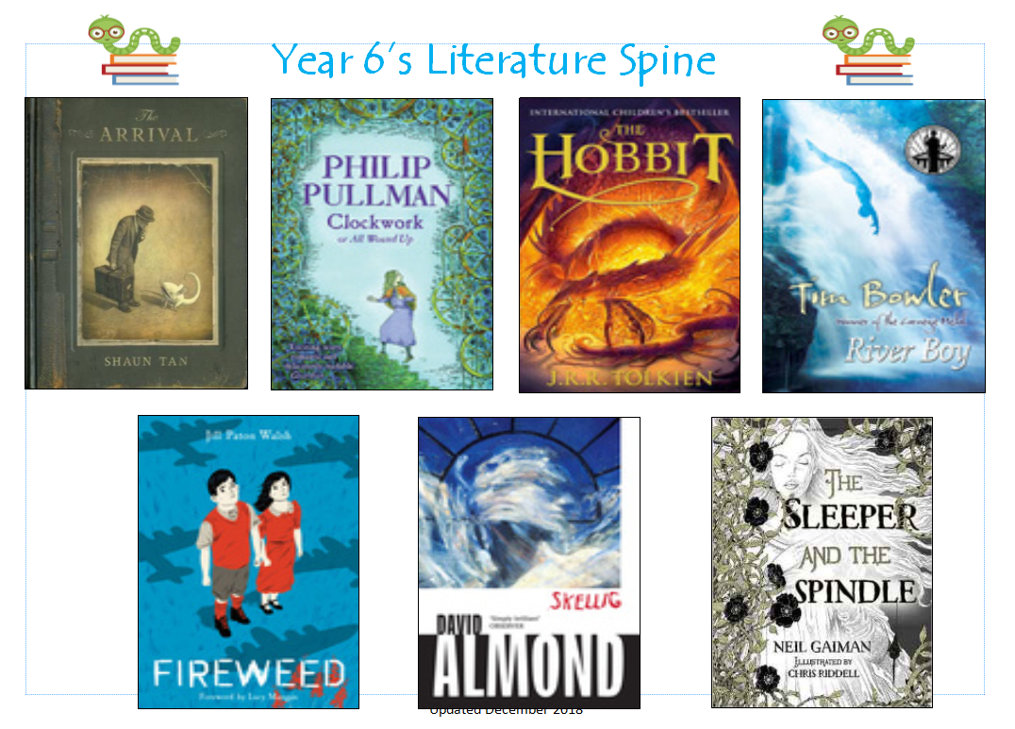
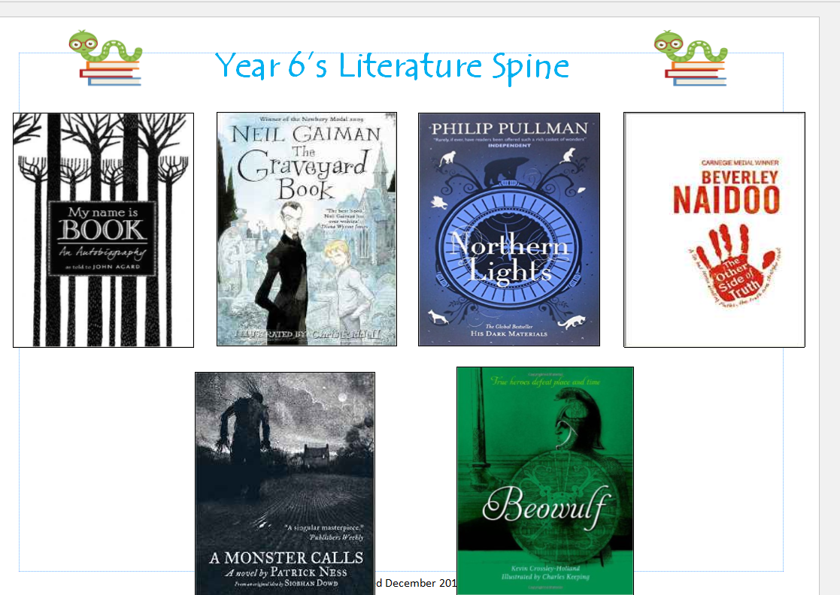
English
Daily lessons which are split between writing, reading comprehension, Grammar, Punctuation and Spelling (GPS or SPaG) and Dictation.
Lessons are taught from our Literature Spine.

Slide 9
Reading
A mixture of guided reading and whole class reading in Year 6.
Reading sketchbooks
Your child will have the opportunity to go to the library where they can borrow books of their choice. Library readers are expected to read a varied 'diet' of books through the year.
‘Stage’ readers must read at least twice per week to an adult at home.
Please ensure your children take care of books. There is a £5 charge for lost library books.
There is potential for our school library to open after school on a Monday to pupils and parents.

Slide 10
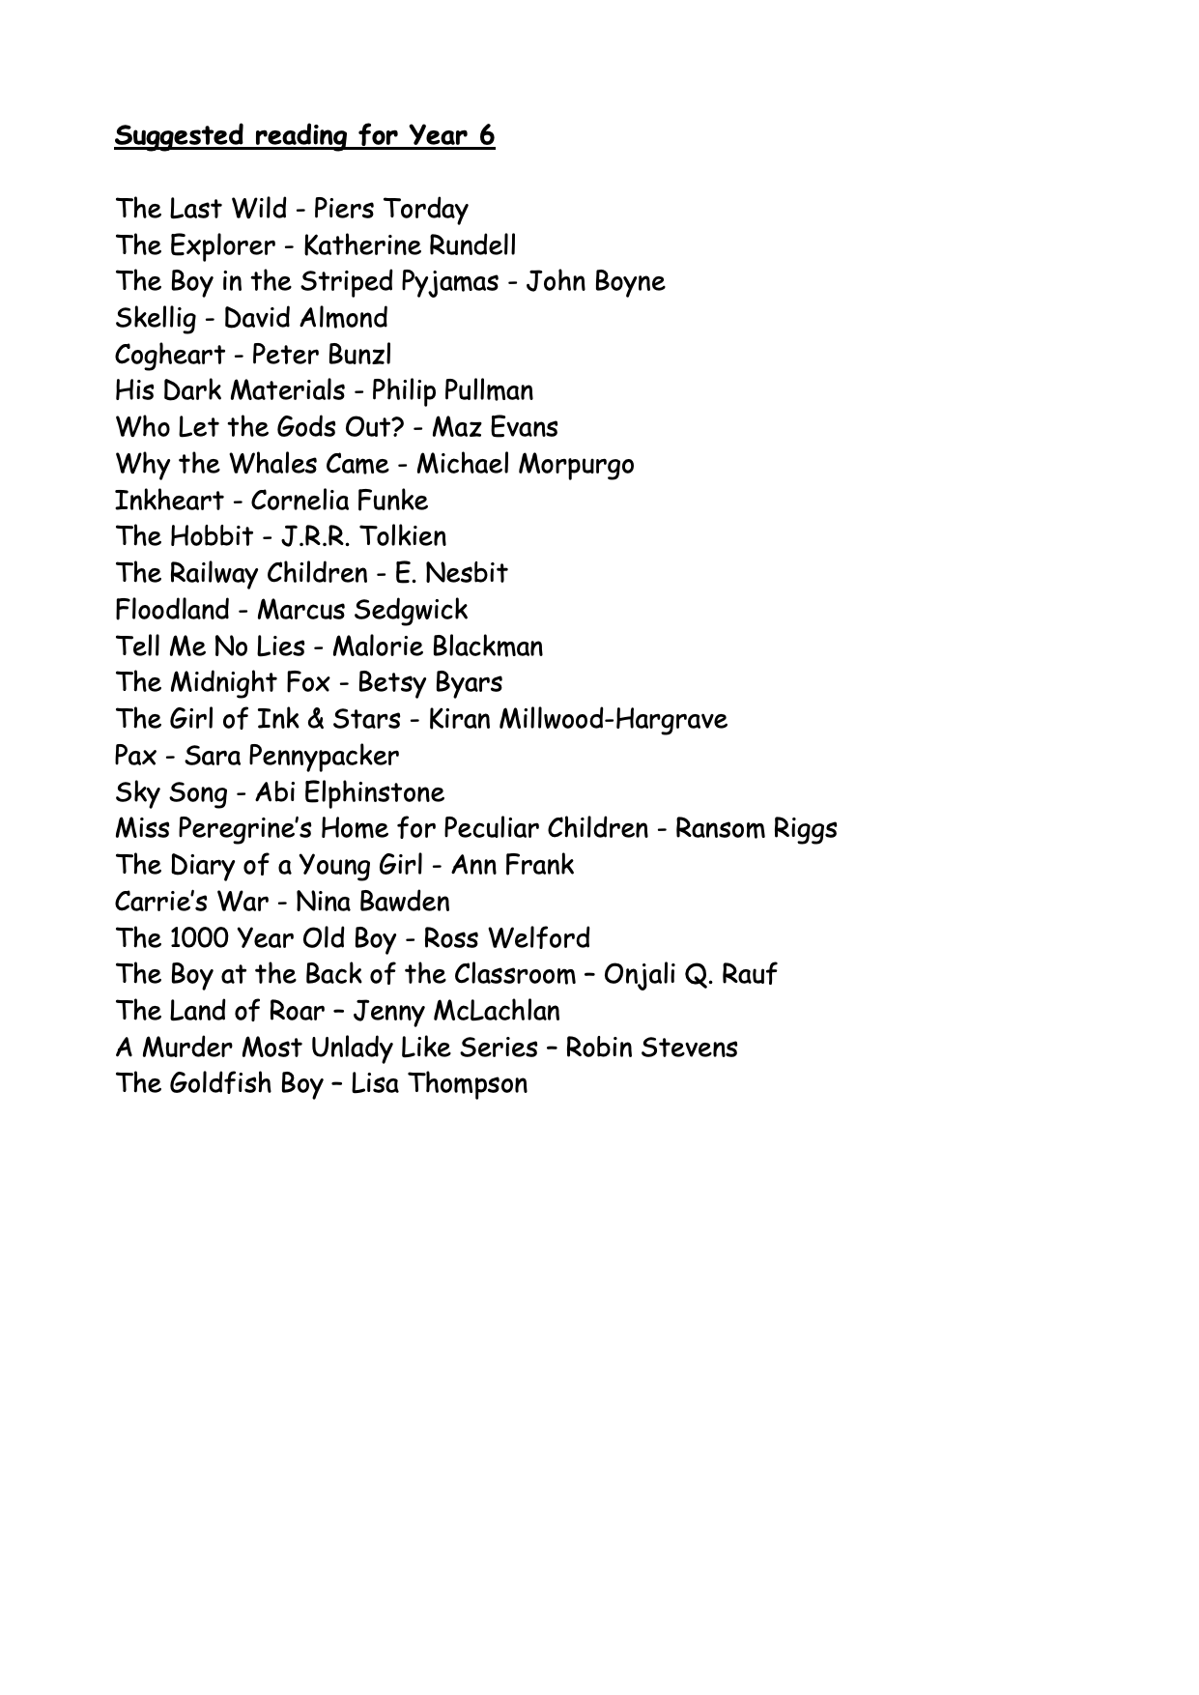

Slide 11
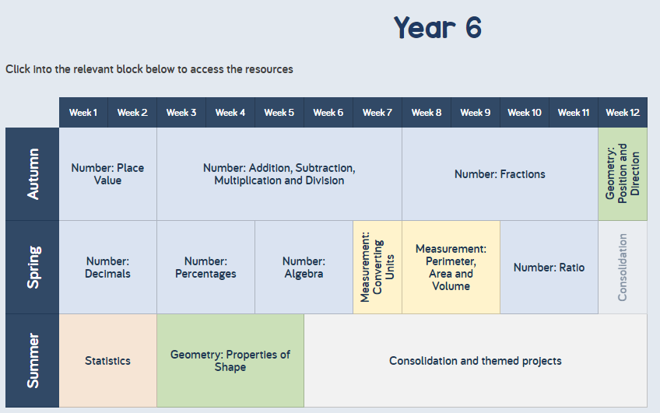
Maths
We teach from White Rose which is a Maths scheme of work, which is then adapted to support as well as challenge learners.

Slide 12

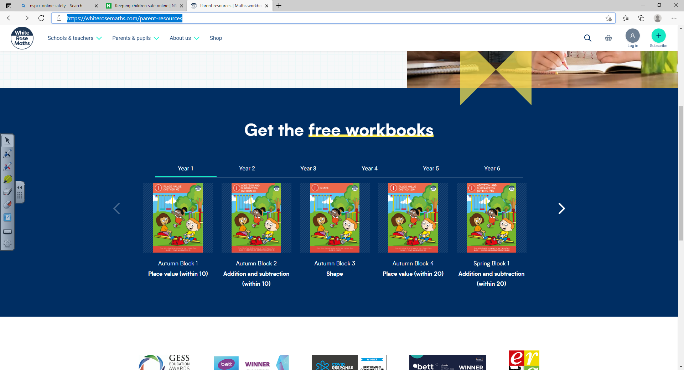
Maths Websites
Times Table Rock Stars
https://ttrockstars.com
Parent resources | Maths workbooks | White Rose Maths

Slide 13
P.E.
Please send your child to school wearing their PE kit on Fridays.
This should be: White St. Peter’s t-shirt (house colours are optional), black shorts or joggers and trainers or black pumps. They may also wear a plain black jumper or hooded jacket (school jumpers are fine).
Children should not wear branded sports clothes.
Our first P.E unit is Handball.
If your child requires an inhaler or Epipen, please ensure school has at least one that’s ‘in date’.

Slide 14

School Games Values
These our the school games values that are promoted throughout schools around the country and they a variation of the Olympic Values followed by our countries sportsman and women. We are focusing on these in PE and during sporting competitions and will help to children understanding the behaviour focus behind sport as well as enjoying the physical activity involved.

Slide 15
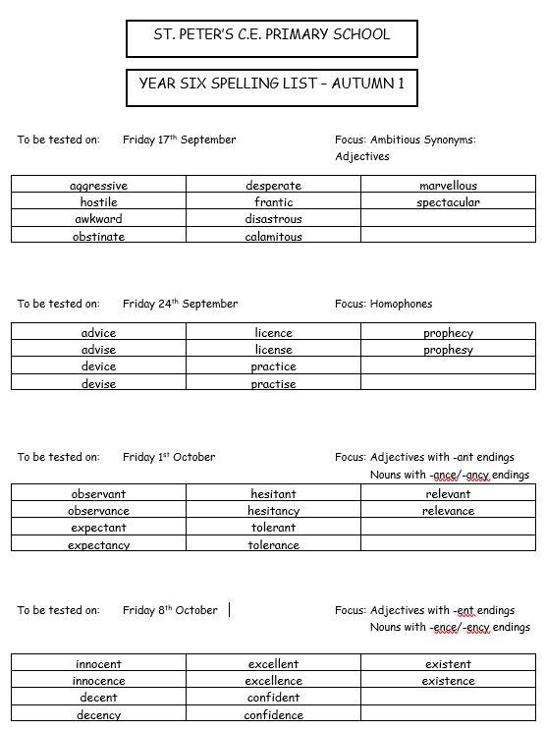
Homework
Currently, we provide a paper copy of spelling homework. Your child will be given their spelling list at the beginning of each half term. This should stay at home and be regularly practised.
The children’s spelling attainment will be assessed through their writing and half termly dictation exercises, rather than weekly tests.
If your child takes part in a spelling intervention, the words they learn will be personalised and it is vital they are practiced at home.

Slide 16
Homework
For English and Maths homework, we primarily send home work to be completed on paper.
Tasks can sometimes link to the current topic and provide opportunities to think beyond the work we complete in school.
It is imperative that your child completes their homework as this is excellent preparation for secondary school.
Homework is given out on Fridays and to be returned the following Wednesday.

Slide 17
SATs assessments
Monday, 11 May to Thursday, 14 May 2026
In the Summer term, your children will complete the SATs assessments.
Reading paper - 1 hour, 3 texts with comprehension questions
GPS - 1 hour with a 20 question spelling test
Maths - 3 papers. 1 arithmetic paper and 2 problem solving papers.
Writing is assessed internally by class teachers
All Year 6 children should be present and at school on time during that week.

Slide 18
Extra Curricular Activities
Trips
Educational visits will be linked to R.E and topic work.
Consent forms will be issued via Arbor.
Residential
The Year 6 Residential is due to take place this year.
Pupils will stay in the Lake District for five days and will be an action-packed week involving hiking, a visit to a Go Ape centre in Grizedale, and a boat trip on Lake Windermere.
Clubs
We hope there will be opportunities for clubs to resume this academic year.
Music lessons are available and these take place during the school day.

Slide 19
School Website
www.st-petersce.co.uk
Child Section – Class page, gallery and Kids Zone.
Parents Zone – Newsletters, letters and important notices.
Most communications from the school with come from signing up to Arbor.

Slide 20
Thank you for taking the time to read through this information.
If you have questions, please speak to your child’s class teacher.

