Slide 1

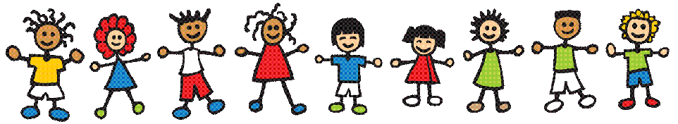
SEN Coffee Morning
Speech & Language
St. Peter’s CE Primary School

Slide 2

Aims for this session
To explain the different areas of speech and language.
To share how we identify children with S&L needs at St. Peter’s.
To share how we support children with S&L needs.
To offer support and suggestions as to how you can support your child with their S&L development at home.

Slide 3
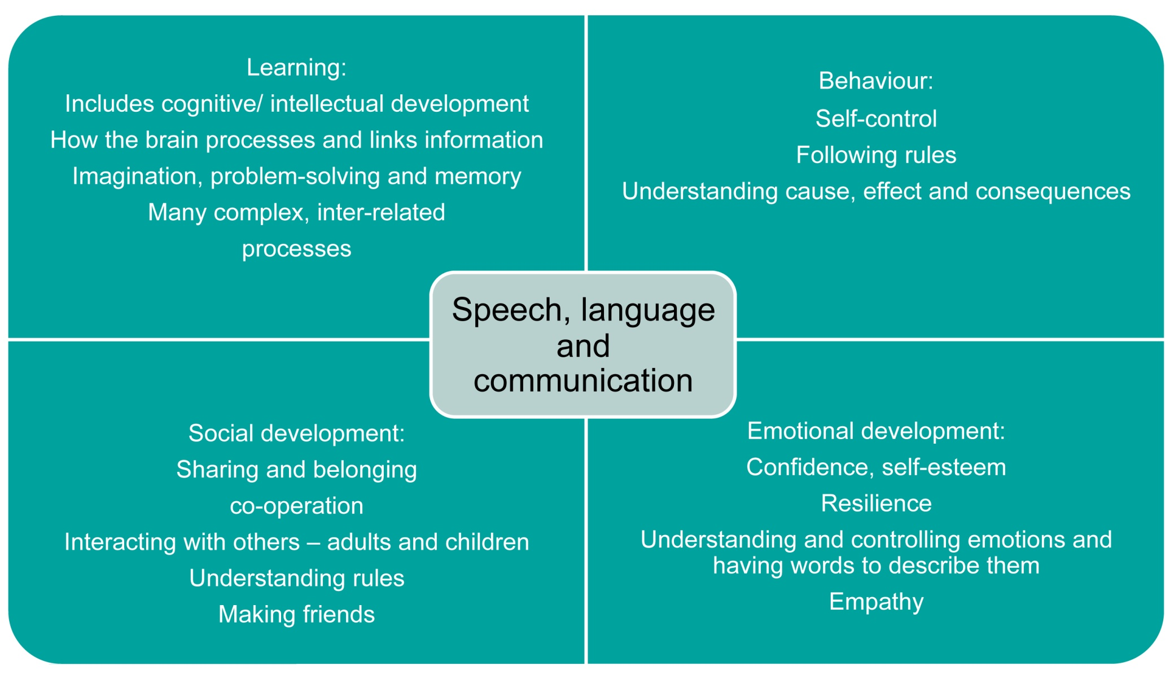
Why speech, language and communication skills are so important

Slide 4
Why speech, language and communication skills are so important
Reading
Reading comprehension
Reading aloud and use of expression
Spelling
Phonological awarenss (letter sounds)
Rhyming patterns
Talking and Listening
Sharing views and opinions
Giving and following instructions
Writing
Use of vocabulary
Order of words in sentences
Use of correct grammar

Slide 5

A growing area of concern…
It is estimated that in some parts of the UK up to 60% of children start school with some form of speech, language or communication delay or disorder (ICAN).
Most of these difficulties are due to language deprivation and with the right support can be resolved…..
…..Only 10% of children have difficulties that are persistent and long term.
Notes:
St. Peter’s picture: Rec: 25% ¼ of pupils

Slide 6
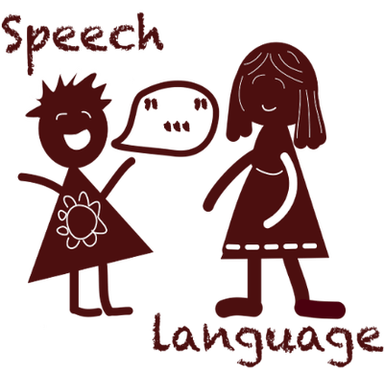
What are the different areas of Speech & Language?

Slide 7
What is speech, language and communication?
Children put together what they have heard, and UNDERSTAND
Children plan and organise what they will say
Children use words to share meaning - TALKING
Children hear,
attend and listen
Children make and use sounds to form words - SPEECH
Using language to interact with other people – COMMUNICATION
Children have to want, need and be confident to communicate
Notes:
Supporting notes:
Speech, language and communication are complex skills which interact greatly with each other. This diagram aims to show what speech, language and communication are. This can be described as a process, from listening, through understanding, planning and talking
The grey boxes describe language; understanding (sometimes called comprehension or receptive language) and talking (sometimes called expressive language). Language has structure and rules, which mean that people can convey their message and be understood by others
The yellow box shows speech, which is how children use sounds to make words
The orange box show how we use language with others. This can include non-verbal communication such as eye-contact, turn-taking as well as how conversations work.

Slide 8
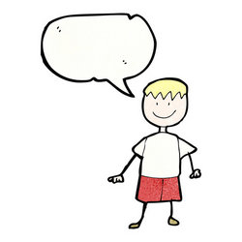
Speech is…
                The sounds we use for talking – articulation of sounds.
                As well as the sounds we use, it also includes
                factors such as:
    fluency
    volume
    intonation and stress on different words
    pitch
Notes:
Supporting notes:
Articulation of sound
Co-ordination of the tongue, teeth, soft and hard palates, abdominal muscles and breath to produce sound.
Speech involves language because you have to have a thought to articulate and then be able to construct this thought into words.
Speech has rules which dictate the order in which sounds can happen to make words:
For example, in English ‘sr’ cannot start a words, but ‘sp’ can
Different languages have different rules and in some cases use different sounds – this
may be relevant for children who are learning more than one language
There is a developmental order in which children typically learn sounds
Children’s speech development and understanding of sounds is really important for
literacy development
Fluency – many children go through a phase of stammering or stuttering; where their
ideas are ahead of their ability to put the words together effectively.
Volume
Young children often do not control how loud or quietly they speak as well as older
children – perhaps saying embarrassing things at top volume!
Stress on different words can quite subtly change meanings for example, the
difference between “these shoes are small” or “these shoes are small” – where the
first example is comparing different shoes and the second example is emphasising the
size. Thinking of more examples with different stresses is also a good activity
Some children do not have much control over their pitch, but show that they are
learning flexibility with this skill, for example using a high pitched voice when
pretending to be a character in role play or a story.

Slide 9
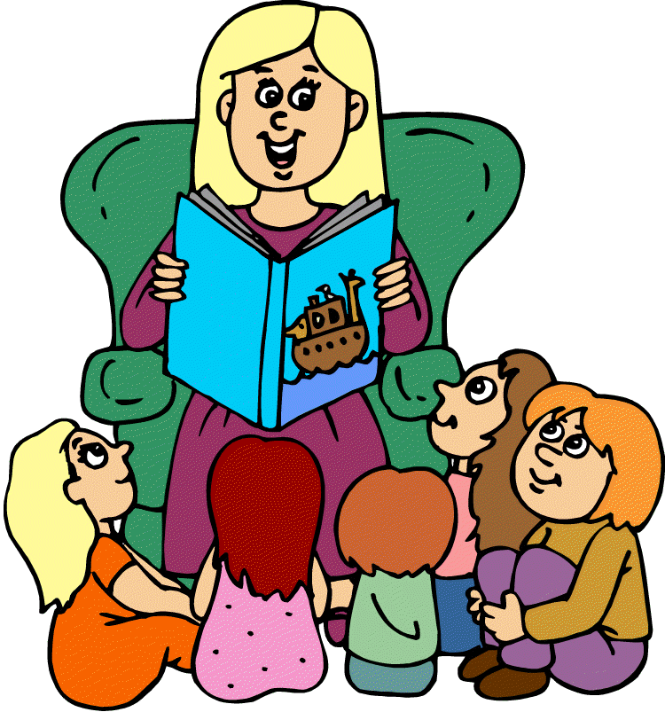
Language includes…
    Understanding and talking use the following:
    Words (vocabulary) and their meanings
    How words go together – their order and how this can change meanings (e.g. the difference between statements and questions)
    Grammar – for example how word endings change meanings (e.g. past tense)
    Sentences joining together to make sense – narratives, stories we share with each other
    Higher level skills such as reasoning,
    inference
Notes:
Supporting notes:
These points are relevant for understanding and talking
Learning language is very complicated.
Language includes a complex sets of rules. It can be seen like a set of building blocks, where words are added together to make phrases and sentences. Some words can be added to and changed. For example adding an ‘s’ to show more than one of something or adding ’ed’ to show something happened in the past.
However, English is full of lots of exceptions and irregular words. For example one child, two children or “I went to the park” rather than “I goed.”
As children get older, they can do more complex things. For example their sentences are longer, with more complex grammar and ideas and these ideas are linked together in stories or narratives. This is the same with understanding.
When we use the word ‘stories’, this doesn’t just mean making up a pretend story. Much of what we share is like a story. For example what we did at the weekend, what’s happening in an activity, what happened when someone bumped their toe outside. These conversations can be described as stories, as they often have a sequence of events with people (characters) and a point or a purpose.
Higher level skills are really important and look at how we put together language with our knowledge of the world. For example, if I say “I think I’ll take my umbrella today’” what do you understand? That I think it’s going to rain. This is a good example of combining the language which is said with world knowledge and previous experience to make an inference. The words don’t say that it is going to rain, but you infer it.
It may be useful to highlight that in typical language development, children need to understand a word before they will be able to use it. Understanding precedes use.

Slide 10
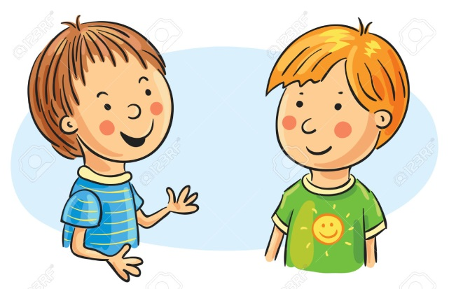
Communication involves…
    Non-verbal communication – for example body language, facial expression, eye-contact, gesture and signing
    Conversational skills and rules – for example listening, turn-taking, knowing when and how to start (and finish) talking, how to change topic and using language in different ways.
Notes:
Supporting notes:
Non-verbal communication describes the skills that don’t rely on speech or verbal communication
Non verbal communication accounts for a good deal of meaning in our communication
Good ways to demonstrate this are by:
Having mixed messages. For example saying “I’m really pleased to see you” with a cross or miserable face
Giving people communication barriers. For example secretly telling them they must not make eye contact during a conversation and then seeing how others (and they) felt
Using the same message but for different people or purposes. For example asking a friend to lend you five pounds versus asking your boss for a pay rise.

Slide 11
Speech, Language and Communication Needs (SLCN)
    Most children follow the expected pattern of development for their speech, language and communication at the expected times. Some, however, do not.
    Most of these children experience a language delay. This is when language development follows a normal pattern of development but at a slower rate (see stages of language development chart in your pack).
A few children may have a disorder. This is where their language development is different in form or function from other children.
Notes:
Supporting notes:
The Communication Trust booklet Explaining SLCN may be a useful supplementary resource
Children may have difficulty in one or more areas of speech, language and communication
Their difficulties can be at different levels, for example, they could have slight difficulties in all areas or a significant difficulty in one (or any other combination)
It is important to stress that these can be exacerbated by poor support in the environment . For example adults saying too much or using too complex language. Practitioners should not focus on the child doing things ‘wrong’.

Slide 12


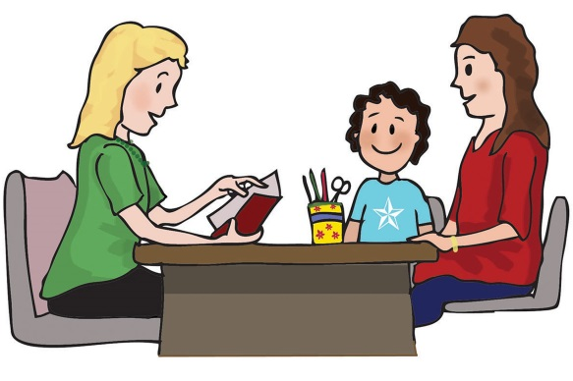
How do we identify children with S&L needs at St. Peter’s?
Notes:
Wellcomm S&L assessment tool: enter nursery/reception and if teacher raises concern; suitable for Early years children to the end of yr 1, beg of yr 2.
Communication trust progression tools: Yr2 - Yr 6
Information or concverns raised by the teacher through their own asessments and through discussions with parents/carers

Slide 13

How do we identify pupils’ S&L needs?
On entry to Nursery/Reception class:
Information from parents &/or previous settings
Practitioner observations & initial assessments
Assessment tool:
Wellcomm Speech & Language Assessment Toolkit
Little Bee Speech Articulation Assessment
Already in school:
Concerns raised by parent/carer or class teacher
Pupil Progress meetings – concerns raised regarding progress
Assessment tool:
EYFS/KS1 – Wellcomm Speech & Language Assessment Toolkit
KS1 – KS2 – Communication Trust Progression Tools
Little Bee Speech Articulation Assessment
Notes:
The assessment tools are diagnostic assessments – which means they provide a picture of the childs’ strengths and areas of concern.
This enables us to target the areas of S&L that the child needs to develop.
The assessment tool also provide an overall assessment of their S&L development – Traffic light system Red – Amber – Green
Any pupils that fall within Red and Amber are provided with some sort of additional provision.

Slide 14
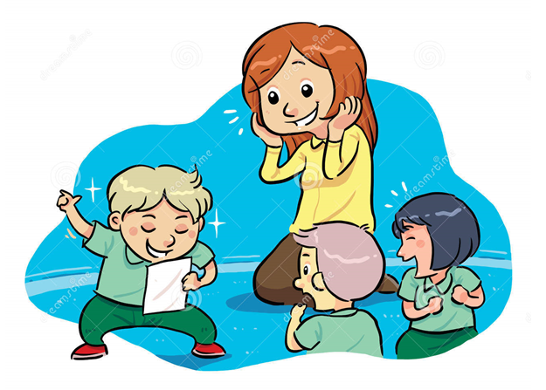
How do we support children with S&L needs?
Notes:
We feel children's language development is a priority. Feeds into the other areas of learning, particularly literacy skills.
Employed Kate! To support the delivery of targeted support.

Slide 15
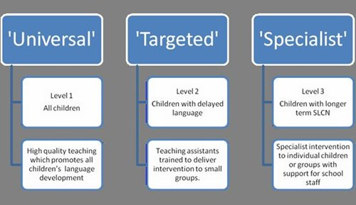
How do we support pupils identified with S&L needs?

Slide 16

How do we support pupils identified with S&L needs?
Depending on area and level of need (Amber or Red):
Two to three targets are identified to work on for a period of six weeks
Children work on their targets; either in groups with up to three other pupils with similar needs, or one to one sessions
Progress towards targets is checked on average every six weeks
Overall progress and attainment is assessed using the progress tools every six months
The information is also shared with the class teacher and other staff who work with the child so their needs are met in class
Notes:
Additional resources organised by the class teacher: examples laid out/pinned up

Slide 17
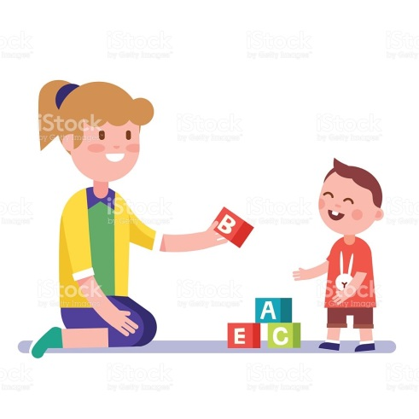
How do we support pupils identified with S&L needs?
If a child falls within the Red area:
Progress is closely monitored
Children who make rapid progress continue on the path of receiving targeted intervention to support their S&L needs.
If a child does not make progress in the first few weeks we will seek permission from parents to refer to NHS Speech & Language Therapy Service (SALT) for an assessment.
If a child receives a package of care, we will work with the NHS Speech Therapist in order to work on the same targets.
We share the outcomes of our 6 week progress check and 6 month assessments with the NHS S&L therapist to support their assessments and next steps.
Notes:
If a child only falls within red for Speech – articulation we would also consider how this is affecting other areas of their learning, particularly writing, spelling and being understood by others.
If severe and affecting these areas, we would be more likely to refer without waiting.
Waiting list for an assessment S&L is long .. Up to 6 months. In our experience SALT will only provide a six week package of care for the most severe cases and then discharge if making or not making progress!
If you receive an appointment please attend! If you miss the appt for any reason your child will be discharged from the service and you will need to start the process again.

Slide 18
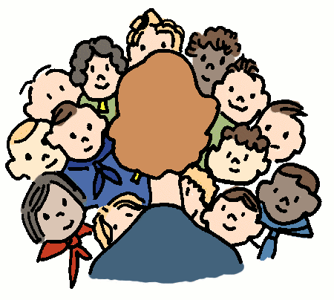
How S&L is supported in class –
High Quality Teaching (HQT)
Modelling of language
Talk and instructions kept simple
Plenty of time and opportunities to respond
Pre-teaching of topic vocabulary
Checking understanding of vocabulary
Reinforcement of vocabulary and concepts with visual aids and real life objects/activities eg: visual timetable, taskboard.
Open ended/differentiated questioning - encouraging child to continue, reinforce and expand on their ideas
Use of appropriate additional resources such as word webs, mind maps, story frames
Notes:
Lemon activity here

Slide 19
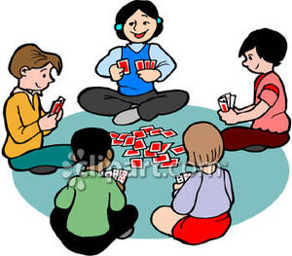
What do the S&L sessions involve?
Notes:
Video clip? Colourful semantics?

Slide 20
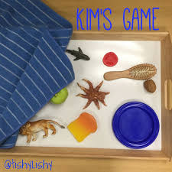
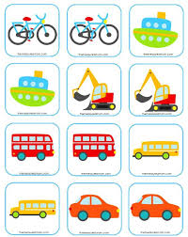
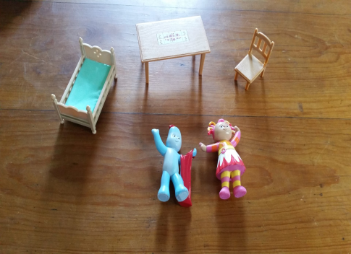
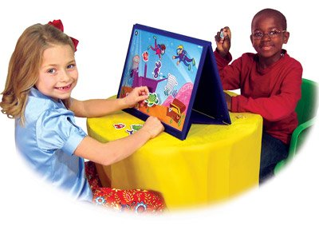
Listening Activities
Kim's game (hidden objects, what’s gone?)
Picture match
Information carrying word activities such as: small world actions, dressing teddy/dolly, object and place, object and colour. E.g. 3 word level, put daisy on the chair. This can support you in knowing how many instructions your child can follow at one time e.g. get your, coat, bag and put your shoes on.
Barrier games.
These games will support turn taking, auditory and functional memory skills, following instructions, listening skills as well as receptive and expressive language skills.

Slide 21
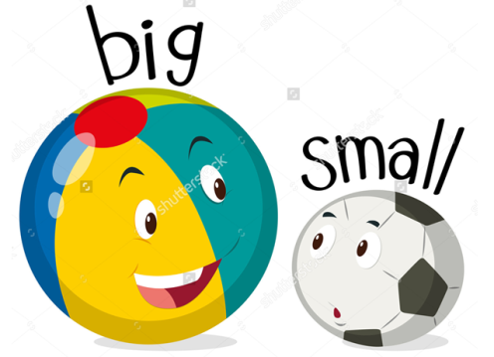
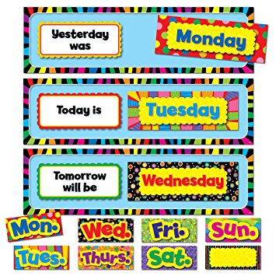
Concepts
Same/different
Long/short
Big/small
Days/parts of days
First/next/last
Before/after
Prepositions

Slide 22
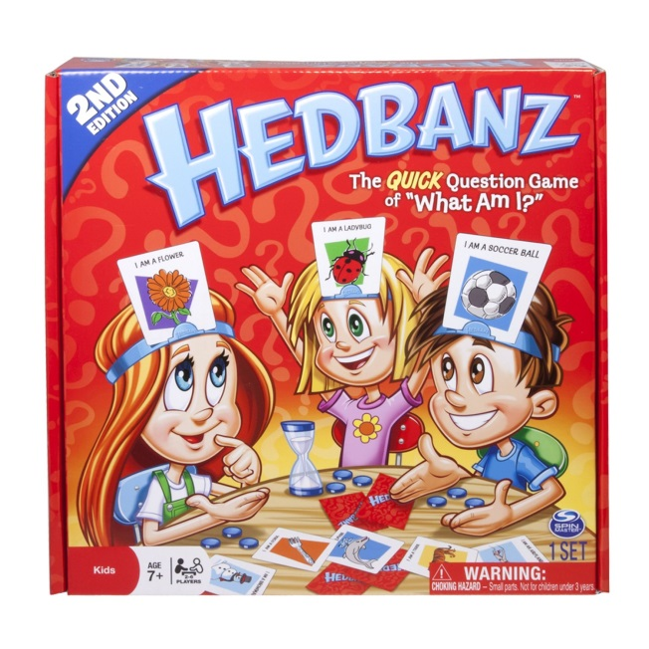



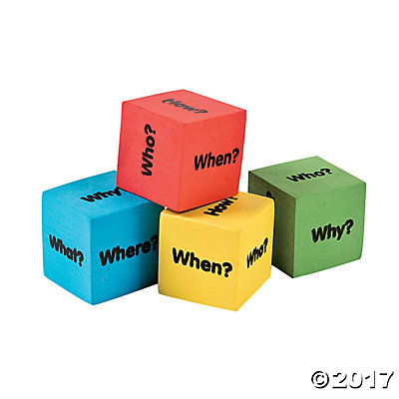
Questions
Where?
What?
When ?
Who?
Why ?
How?

Slide 23
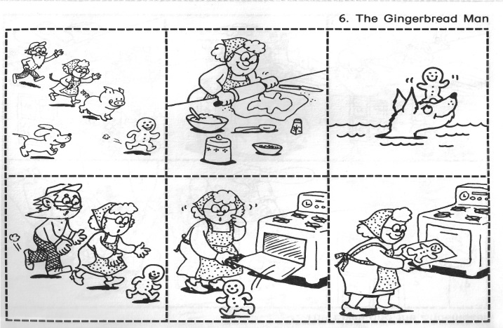
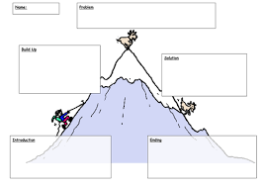
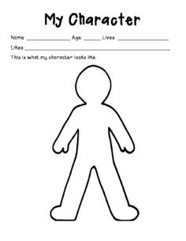
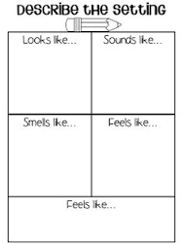
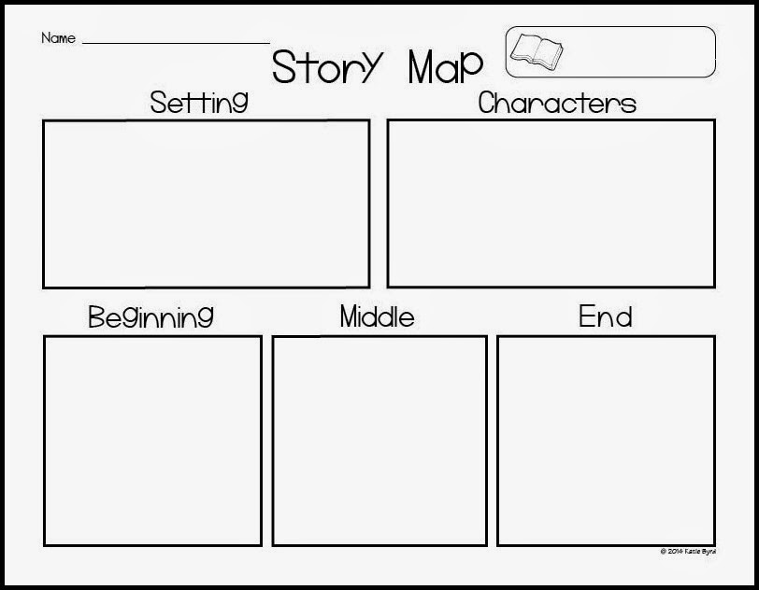
Narrative

Slide 24

Sentences and grammar
Colourful semantics-
Which children will benefit from Colourful Semantics?
• Children with a reduced vocabulary.
• Children that struggle with word order.
• Children that have speech difficulties.
• Children learning English as a second language.
• Visual learners.

Slide 25
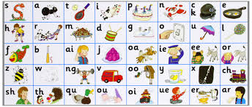
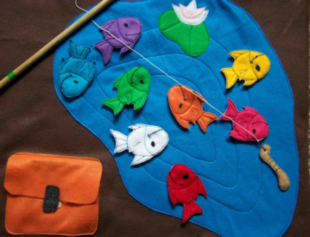
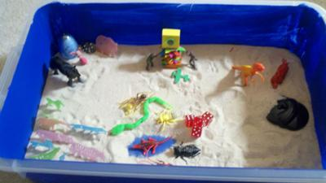
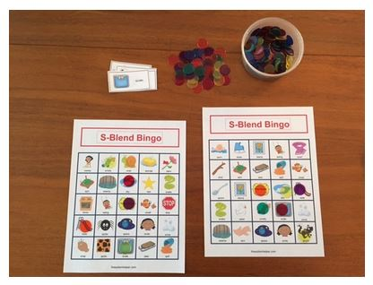
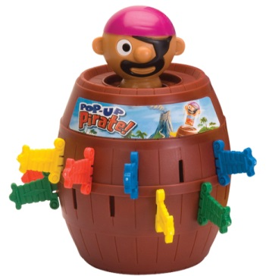
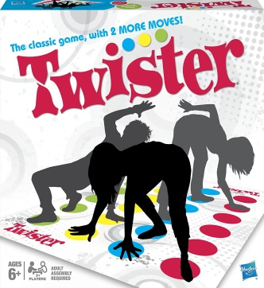
Speech
Jolly Phonics
We have fun practising speech sounds, using games the children enjoy!

Slide 26
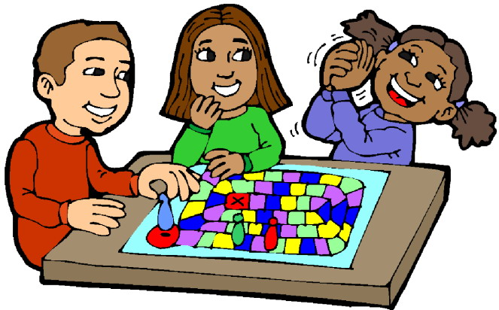
How can you support your child at home?

Slide 27
What affects language development?
Research evidence shows:
The amount of language children hear is important
What adults say to children is also important
Co operative interactions are very important
The more they hear, the more time their parents spend talking with them and the more types of words they are exposed to, the more children use.
Children seem to develop strong language skills when parents ask open-ended questions, ask children to elaborate, and focus on topics of interest to the child. Responding to what the child is talking about and having familiar routines also promote shared understanding.
Conversations about how people feel and how that affects what they do, are important in learning social communication skills.

Slide 28
Top tips!
Keep instructions simple – how many instructions are you giving your child in one go?
Allow your child opportunities and time to respond to you – ask open ended questions
Modelling good language. This is the adult repeating back correct or elaborated language rather than asking the child to repeat/correct:
Elaborate their observations: “look, bus” – “Yes big red bus”, “nice cake” – “delicious cake”
Re-order/extend a sentence: “Ball me kicking” – Yes, you are kicking the ball”, “Lady pushing pram.” – “The lady is pushing a pram.”
Correcting grammar: “I falled over!” “Oh dear, you fell over!”
Correcting speech sounds: “ a pider!” – “yes, a spider!”
Talk about what you are going to do ahead of doing it to give your child the opportunity to practise any new vocabulary
Notes:
Part of every day life rather than a formal exercise. MAKE IT FUN!
Handouts!

Slide 29
    If you have any concerns that your child may have speech and language difficulties please speak to your child’s class teacher

