Slide 1





DYSLEXIA
Parents Workshop
Pupil and School Support
St. Peter’s CE Primary School
Partners on the pathway to a positive future for children and young people
Notes:
Introductions
PSS – Part of integrated Services within Birmingham City Council – Children, young people and families.
Work with all mainstream schools to improve outcomes for pupils with cognition and learning difficulties.
Includes whole school systems, identification of SEN – provision etc.
Individual pupil assessments to identify strengths and weaknesses
Training for teachers, TAs

Slide 2
Aims
By the end of the session you will :-
Have an increased knowledge and understanding of definitions of dyslexia and be aware of some of the common characteristics associated with dyslexia
Have an increased understanding of some strategies to support dyslexia
Have an understanding of Access to Education’s identification process
Notes:
At the end of the session you will:
have an increased knowledge and understanding of dyslexia
have an understanding of the varying definitions of dyslexia
be aware of some of the common characteristics associated with dyslexia.

Slide 3
What is it?
Notes:
Huge variety of opinions – media, lots of ongoing research definitions change all the time!

Slide 4
What is Dyslexia?
Dyslexia is one of several specific learning difficulties (SpLD)
It is a learning difficulty that primarily affects the skills involved in accurate and/or fluent word reading and spelling
It is derived from two Greek words :
dys = difficulty
lexia = words

Slide 5
What do you know about Dyslexia?
Look at the True / False sheet.
It contains statements that you may have heard in the media or read.
Which are true and which are false?
Discuss with the people on your table or the person next to you.
Notes:
So what do you know about dyslexia? The following are all statements that you may have heard in the media or read. Which are true and which are false? Discuss with the people on your table or the person next to you.
5 to 10 min
Feedback
All true. Four boys are affected to one girl. – query this could be because it is under identified in girls.

Slide 6
 | True or false?
Dyslexia occurs across the ability range?
There are dyslexic children in every classroom and dyslexic adults in most staff rooms?
5% of the population are severely dyslexic and an estimated 10% have some associated difficulties?
Dyslexia is a learning difference – a combination of strengths and weaknesses which affect the learning process in reading, spelling, writing and sometimes number and calculation?
Dyslexic learners may also have co-occurring difficulties with short-term memory, sequencing and the speed with which they process information?
Dyslexia has physiological basis – research indicates neurological differences which generally affect the left hemisphere, which deals with language and sequential processing?
Dyslexia runs in families?
Dyslexia occurs on a continuum from mild to severe?
Dyslexia occurs in all ethnic groups and in all languages?
Four boys are affected to every one girl?
Self-esteem is often low which can lead to reduced motivation and sometimes to behaviour problems?
Dyslexic learners can do as well as anyone else when identified and given appropriate support?
Notes:
This information is from the TDA website from training materials for NQTs entitiles – Removing barriers: dyslexia and specific learning difficulties – taught session 4.
All true. Four boys are affected to one girl. – query this could be because it is under identified in girls.
Dyslexia occurs in families – there is some debate about this.
New research is being completed all the time and it is a constantly changing picture.
With that in mind let’s look at possible causes.

Slide 7
Famous dyslexics
Albert Einstein
Whoopi Goldberg
Kiera Knightley
Michael Faraday
David Bailey
Tommy Hilfiger
John Lennon
Nigel Kennedy
Duncan Goodhew
Steve Redgrave
Jackie Stewart
Richard Branson
Ingvar Kamprad (founded IKEA)
Frank W Woolworth
Tom Cruise
Steven Spielberg
Cher
Henry Winkler
Notes:
This is a summary of the activity and recent research
It does occur in all languages but in some languages such as Spanish it is not so prevalent, possibly because it is a phonetically regular language.

Slide 8
What does Dyslexia Look Like?
Occurs across the ability range
5% of the population are severely dyslexic
Every classroom and most staff-rooms may contain a person with dyslexia
4:1 boys to girls
Dyslexia runs in families
Physiological basis
Co-occurring difficulties can include short term memory,
sequencing and processing speed
Can affect reading, spelling, writing letters and/or numbers
Learners with dyslexia can make some progress when given
appropriate support, although this is unlikely to be
accelerated at the word level
Occurs in all ethnic groups and languages.
Notes:
This is a summary of the activity and recent research
It does occur in all languages but in some languages such as Spanish it is not so prevalent, possibly because it is a phonetically regular language.

Slide 9
Definitions of dyslexia
Both the British Psychological Society (1999) and the comprehensive report provided by Jim Rose 2009 provide useful definitions of dyslexia;
‘Dyslexia is a learning difficulty that primarily affects the skills involved in accurate and fluent word reading and spelling.’ (Rose, 2009)
‘Dyslexia is evident when accurate and fluent word reading and/or spelling develops very incompletely or with great difficulty.
This focuses on literacy learning at the ‘word level’ and implies that the problem is severe and persistent despite appropriate learning opportunities.
It provides the basis for a staged process of assessment through teaching.’ (BPS, 1999)
Notes:
The definition used in Birmingham
Over 40 working definitions
All have some kind of phonological element.
Psychological society – word level but also appropriate learning opportunities. (Reading and spelling)

Slide 10
Current Research
Sir Jim Rose (2009) concluded in his report that:
1) Characteristic features of dyslexia are difficulties in phonological awareness, verbal memory and verbal processing speed.
2) Dyslexia occurs across the range of intellectual abilities.
3) Dyslexia is best thought of as a continuum, not a distinct category and there are no clear cut off points.
4) Co-occurring difficulties may be seen in aspects of language, motor coordination, mental calculation, concentration and personal organisation but these are not, by themselves, markers of dyslexia.
5) A good indication of the severity and persistence of dyslexic difficulties can be gained by examining how the individual responds or has responded to well-founded intervention.
Notes:
In June 2009 Sir Jim Rose published his research on Identifying and teaching children and young people with Dyslexia and literacy difficulties.
Have a copy of the Rose Report for reference.
Still relates it to accurate and fluent word reading and spelling, but acknowledges other difficulties too. He also identifies it as part of a continuum.
Response to teaching features highly in his report. He talks about one off ‘snap-shot’ assessments only present a picture of the pupils’ needs on that day. He recommends a staged approach of support combined with on-going assessment through teaching

Slide 11
Rose Report
‘It is now widely accepted that dyslexia exists’
‘The long running debate about its existence should give way to building professional expertise in identifying dyslexia and developing effective ways to help learners overcome its effects’
Rose Report p9

Slide 12
What does Dyslexia feel like?
Notes:
Important – empathy – more likely to change your working practices.
Insert Tara, etc

Slide 13
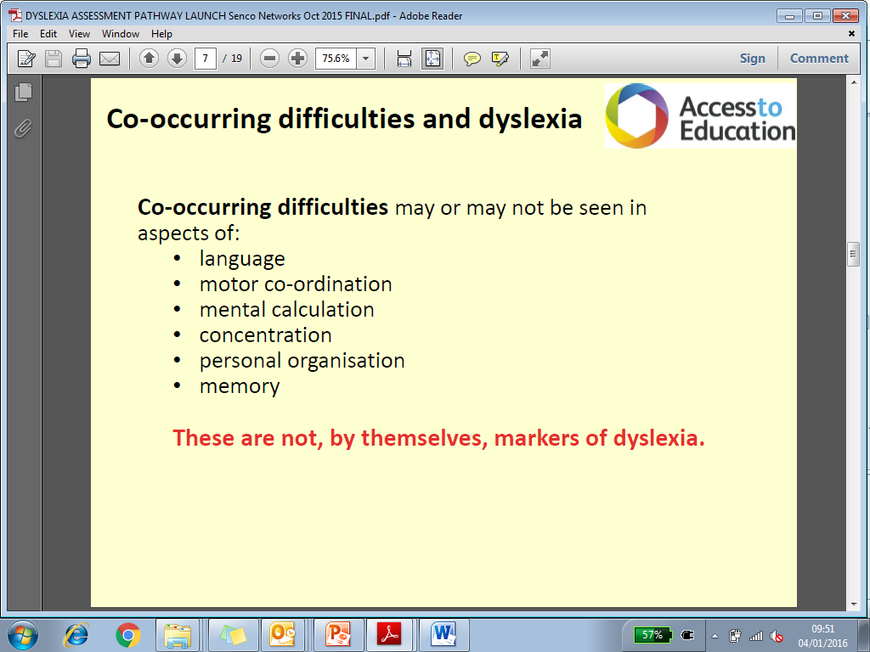
Common Characteristics
Dyslexia can have an impact on a wide variety of cognitive areas and these can influence the behaviours you may see.
Notes:
Table – given the headings (area of difficulty), 10 different possible difficulties. Need to match these to the behaviours you may see and what difficulties they may have in class as a result.
Complete the table in twos or threes. (10min)

Slide 14

Support strategies.
How do we support pupils with difficulties in reading or spelling at St. Peter’s?
High quality teaching in the classroom
(Universal support)
Additional small group support with a Teacher or Teaching Assistant
(Targeted support)
Additional 1:1 support usually with a Teaching Assistant
(Specialised support)

Slide 15
Support strategies.
What does this support look like at
St. Peter’s?
Strategies to support slow processing skills and poor memory
Multisensory strategies – visual, auditory, kinaesthetic
Interventions to support specific needs
A lead member of staff for Dyslexia

Slide 16

Supporting Processing speed and memory:
Clear lesson structure and daily routines
Explicit instructions - broken into smaller steps if needed
A good pace
Check understanding
Peer support
Provide thinking time for asking & answering questions
Provide additional time to pre-read/pre-teach a story or vocabulary
Use a range of multisensory strategies
Use a variety of ways of recording work
Provide time prompts to support time management of tasks
Reduce memory load
Overlearning strategies
Memory aids
Use of ICT
Notes:
Speed of Processing Language
How quickly a learner can react to incoming information, understand it, form a response and execute it; can relate to retrieval of information already known of (similar to working memory)
May be influenced by : neurological factors or affected by knowledge and experience (Can all relate to this when returning to school after the summer holiday!) About information being sorted on the way in as well as information being retrieved e.g. identifying names of objects including subject specific words e.g. Bunsen burner, volcano, moat, portcullis,
Behaviours observed can be : slow at academic activities, social activities e.g. chatting with peers.
Therefore when activities become automatic/routine - slow processing has a lesser effect. So when suitable, try to use the same activity for teaching a variety of skills e.g. snap can be used for initial sounds, number bonds etc. This will allow focus on key learning rather than the activity itself.
So how can we take this into consideration:
Well established daily routines - with support of visual aids - pictures/ symbols e.g. start of day activities
Well understood instructional routines -make information explicit and relevant to topic
Pace of instruction - at student's pace but not too slow (task boards)
Check understanding of instructions/information before moving on to new information
Peer Support e.g. think, share in pair it together and agree, share whole group etc. More and less able pairings (know the pupils)
Give a question and then come back for the answer in five minutes
Give a ‘warning’ when an activity/focus change is due

Slide 17

Multi-Sensory Learning
AUDITORY
remember what is heard
V . A . K
VISUAL
remember what is seen
KINAESTHETIC
remember when hands or whole body used to learn
Notes:
PROVIDES OVER VIEW FOR NEXT 3 SLIDES
Within this room there will be those of you who will listen to what I say without paying much attention to the slides and resources given out and still memorise much of what is said.
Others of you are scribbling notes to aid memory of what I am saying.
Some will need to touch and use the resources I talk about to memorise them.
This will be just as true here as it will be in each classroom within the school.
Children with special educational needs (and indeed all learners) benefit from information being presented in a variety of ways in order to ensure there is optimum processing opportunity. Making use of as many different PATHWAYS to the brain as possible.
Use of a multi sensory approach is one of the strategies used to support dyslexic learners.

Slide 18
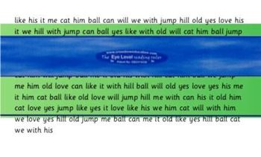
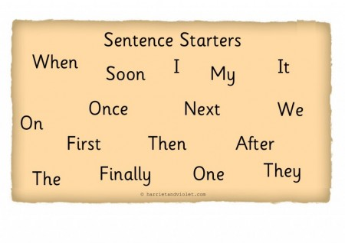
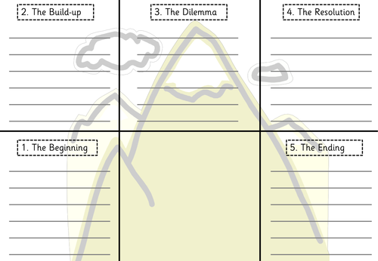


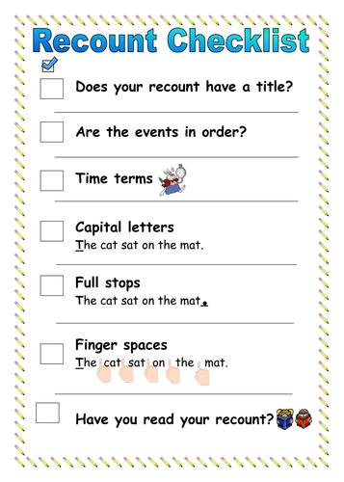
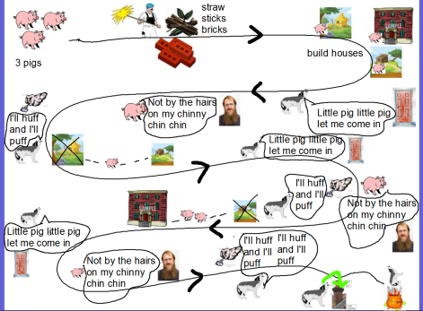
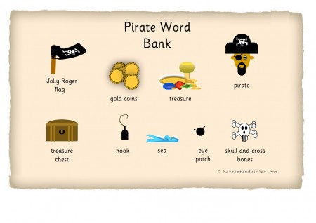

Visual resources/strategies:
Mind maps
Story maps/writing frames
Post it notes
Word banks
Personal dictionaries
Sentence starters
Pictures/symbols
Task board/checklist
Highlighters
Whiteboard, pens
Coloured overlays
100 squares
Number-lines
http://www.enchantedlearning.com/graphicorganizers/
Notes:
This can include using pictures alongside vocabulary lists to the use of visual organisers.
One particular visual strategy is the use graphic organisers:
Background
Graphic organizers (some of which are also called concept maps, entity relationship charts, and mind maps – arguably the most commonly known) are a pictorial way of constructing knowledge and organizing information. They help the student convert and compress a lot of seemingly disjointed information into a structured, simple-to-read, graphic display. The resulting visual display conveys complex information in a simple-to-understand manner.
Increasing Understanding by Creating Graphic Organizers:
The process of converting a mass of data/information/ideas into a graphic map gives the student an increased understanding and insight into the topic at hand. To create the map, the student must concentrate on the relationships between the items and examine the meanings attached to each of them. While creating a map, the student must also prioritize the information, determining which parts of the material are the most important and should be focused upon, and where each item should be placed in the map.
The creation of graphic organizers also helps the student generate ideas as they develop and note their thoughts visually. The possibilities associated with a topic become clearer as the student's ideas are classified visually.
Uses of Graphic Organizers:
Graphic organizers can be used to structure writing projects, to help in problem solving, decision making, studying, planning research and brainstorming.
Creating Graphic Organizers:
Graphic organizers can be drawn free-hand or printed.
Adding colour-coding and/or pictures to a graphic organizer further increases the utility and readability of the visual display.
Many examples of graphic organisers can be found on http://www.enchantedlearning.com/graphicorganizers/
Reference the strategies in the support booklet and that there are resources in the ‘tool box’ – consider audience as some resources may not be appropriate e.g. alphabet arc in secondary (!)
A simple strategy concerns Electronic Whiteboards – use off white background as a default, use interactively e.g. easy to animate pictures

Slide 19
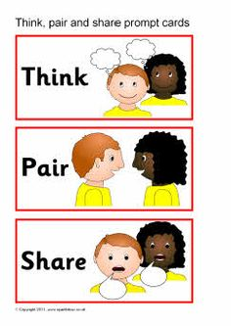


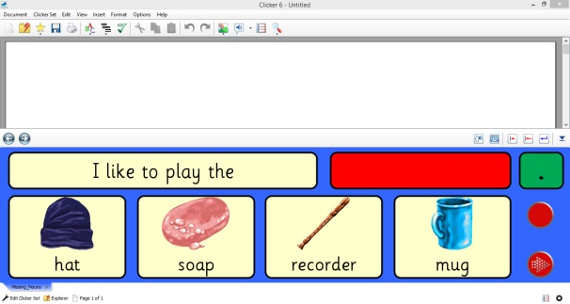
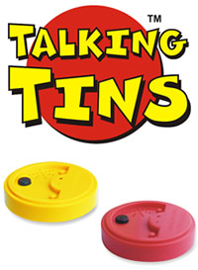
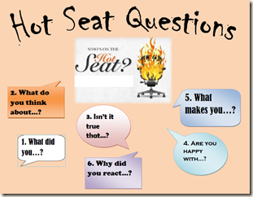
Auditory resources/strategies:
Technologies
‘Text to speech’
Talking tins
‘Clicker docs’
Role play
Hot seating
Talk4Writing
Paired talk: ‘Think, pair, share’
Stepped instructions
Use of rhythm
Repetition
Audio books
Notes:
Although particularly essential at EYFS this needs to carry on throughout school – remembering science facts by generating rhymes, clapping out ‘awkward’ spellings etc
Promote good listening – what does it look like (is as appropriate in secondary as primary) e.g. taking turns, respecting opinions, knowing when appropriate to interject, preparation for asking questions.
Promote active listening e.g. give key words to listen out for, give questions beforehand,

Slide 20

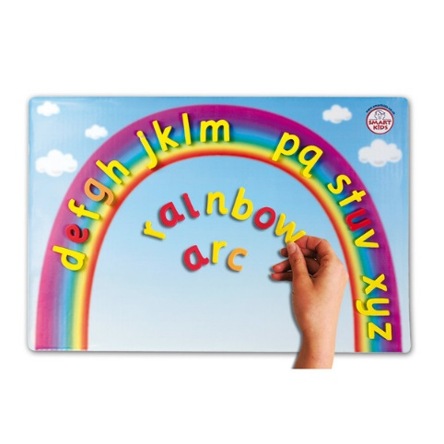




Kinaesthetic resources/strategies
Talk4Writing
Jolly Phonics/Jolly Grammar -actions
Hands-on activities
Cursive script
Physical resources such as…
Alphabet rainbow
Sandpaper letters
Notes:
The word 'kinaesthetic' describes the sense of using muscular movement - physical sense in other words. Kinesthesia and kinesthesis are root words, derived from the Greek kineo, meaning move, and aisthesis, meaning sensation. Kinaesthetic therefore describes a learning style which involves the stimulation of nerves in the body's muscles, joints and tendons. This relates to the colloquial expression 'touchy-feely'.
This can often seem like a difficult one but doesn’t have to be.
ACTIVITY
e.g. spelling rhythm – all stand, presenter wiggles hips and says “rhythm has your two hips moving” ALL COPY
or
Write something on a partners back – partner guesses what has been written
Or
Tracing letters in the air for letter formation
Or
An activity that you feel comfortable with -
Other Strategies:
Sentence construction – pupils can be different elements of a sentence and have to move around to make it make sense.
Ordering recipes and other instructions – cut up and rearrange

Slide 21


Specific interventions:
Reading:
‘Paired reading’ (1:1)
‘Reciprocal reading’
Coloured reading rulers/paper/overlays
Learning to use ‘Text 2 Speech’
‘Precision Teaching’
Writing:
Touch typing
Learning to use ‘Speech 2 Text’
Spelling:
‘Wordshark’, ‘Squeebles’, cued spelling, mnemonics, word frames, ‘Style Tiles’, ‘Look, Say, Cover, Write, Check’, ‘Precision Teaching’, ‘Five Minute Box’, ‘Accelerread, Accelerwrite’.
Notes:
Weekly spelling test – not the most useful approach to developing spelling = Anecdote; child sitting out in car practicing spellings. Mum takes him into school and insists that he has to take the test immediately. Teachers explains that yes it will be done immediately after registration, Mum explains, frantically, that it has to be done now! (tell with humour) – emphasis is that spelling needs to be committed to long term memory rather than drilled for a test.
Refer to examples from resource box of spelling journal, spelling patterns/word families journal or prompt card, spelling rules –
Mnemonics -
Refer to Cued Spelling strategies – include spelling rules e.g. I before E except after C
Don’t forget the learning styles!!!!! E.g. can multi sensory approaches be used?
Cursive Handwriting - Joining helps the memory (muscle memory, also adds kinaesthetic element so not just remembering visually or orally the spelling patterns
How does it look – have several ‘goes’ at the word (could demonstrate this if appropriate)
Look say cover write check – explain how this works. There is a school of thought which says that this is not a dyslexia friendly strategy but if it works for the individual then ‘go for it’.
Word families – common spelling patterns can be highlighted using colour – helps them to stand out.
Left handers -
not being able to see what is written could impact on ability to remember spellings – therefore they may adapt their pen grip.
Alternatives to Using a Dictionary
Rather than suggesting that children look things up in the dictionary, suggest that sometimes if you don’t know how to spell a word it is quite difficult to look it up in a dictionary. If you haven’t got a clue what the first letter is, a word like ‘appropriate’ which starts with an ‘uh’ sound which could be anything, it's much easier to look the word up in a dictionary if you can choose a simpler word. So if you use a thesaurus rather than a dictionary it’s easier to find those words. So a word like ‘enormous’ can be picked up by looking up ‘big’. ‘Big’ is easy to spell and so quite easy to look up in a thesaurus and then you will find not just ‘enormous’ but you might want to use another one of the many words that you have got. So it also exposes the children to more vocabulary. Dictionaries are really important for meaning and once you can spell, that’s the medium of choice, but it's just that for struggling spellers a thesaurus is often more accessible.

Slide 22

Self Esteem
Equip them with strategies to support independent learning
Recognise their strengths
Create opportunities to demonstrate their strengths
Use their interests and strengths to engage them in learning
Notes:
The dyslexic student may have difficulties in many areas, there will be areas of strength. Recognising and utilising these strengths is important to the student’s academic and intellectual development. These strengths are important to the self-esteem of the dyslexic student. As with the areas of possible difficulty listed above, dyslexia is very diverse and some strengths will be found in some students and not in others.
Possible areas of strength – Creativity, Problem solving, sociability, leadership, verbal skills
Nurturing these talents within the classroom:
Look for and recognise them
Provide opportunities for students to demonstrate their talents within the classroom
Utilise the talents within literacy and numeracy tasks – work to the interests, e.g. football – write game reports, produce league tables, train or bus timetable to get to away matches, etc.
Provide opportunities to discover and create new interests and talents.

Slide 23

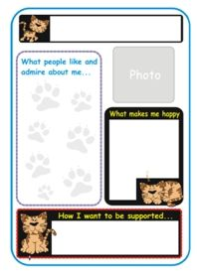
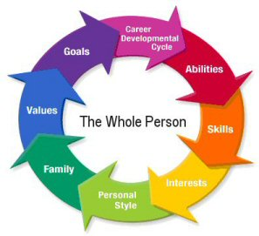
Sharing Information
One Page Profiles
Regular reviews between school staff and parents
Pupil Centred Review between change of setting
Support/advice from outside agencies such as: Pupil, School Support, Educational Psychology

Slide 24
The foundation to Access to Education’s Identification Process
Access to Education have taken into account the most up-to-date research and the BPS and Rose report definitions in order to agree that, dyslexia occurs at the word level in terms of either:
1) incomplete reading and/or spelling accuracy
2) incomplete accuracy and fluency in reading and/or spelling
(Rose, 2009; BPS, 1999)
Access to Education are also basing the identification process on the following:
These difficulties are persistent and severe despite appropriate learning opportunities within an assessment through teaching approach (BPS, 1999) and pupils have made less than expected progress following targeted interventions and the involvement of specialist support that has been tailored to pupils individual needs (SEND CoP, 2015).
Notes:
This is explained in the Guidance.
At this point you may wish to mention the difference between discrepancy model and assessment through teaching . The discrepancy model has been highly discredited – A2E have conducted a literature review of 350 research papers and this evidence supports our decision to use assessmsent over time and reponse to intervention approach.

Slide 25
Identification
There is no single test for dyslexia
Dyslexia is evident over time following detailed and ongoing high QFT
It is a graduated process of observation, assessment, specific tailored support and high quality interventions which are monitored and evaluated for impact on pupil progress
It involves a collaborative approach – class teachers, SENCO, literacy co-ordinators, outside agencies
Includes working in partnership with parents/carers and pupils
Notes:
Current research (Rose Report 2009 & IDP 2011) clearly indicates that identification of dyslexia is not a one off assessment
- QFT is a ‘given’
- Dyslexia can be complex and pupils may have differing degrees of difficulties therefore assessment through teaching over time is important.

Slide 26

Thank you
Any Questions
anne.g.crocker@birmingham.gov.uk
Notes:
Give out Audit of need.
Depending on time –
If there is enough time complete exercise and set 3 actions to be followed up by PSS teacher.
If not, give out sheets to complete in own school time, set 3 actions and follow up with PSS teacher

